Slide 1

FREE PPT TEMPLATES
INSERT THE TITLE
OF YOUR PRESENTATION HERE
ALLPPT.com _ Free PowerPoint Templates, Diagrams and Charts

Slide 2
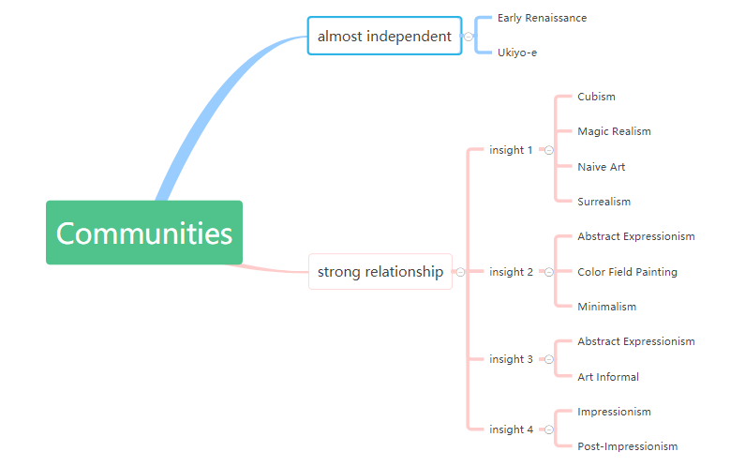
Grivan-Newman Algorithm
Results
We got communities for different styles and plotted them.
Label: <style-id>, it means the node is the idth painting of the style.
Community types:
Some styles are almost separated from others like Early Renaissance
and Ukiyo-e.
Some styles are closed to others, such as Impressionism, Post Impressionism and Color Field painting, Minimalism and so on.
Here’s the relationship between styles we found.
Here’s the Global sight of communities with Pals.

Slide 3
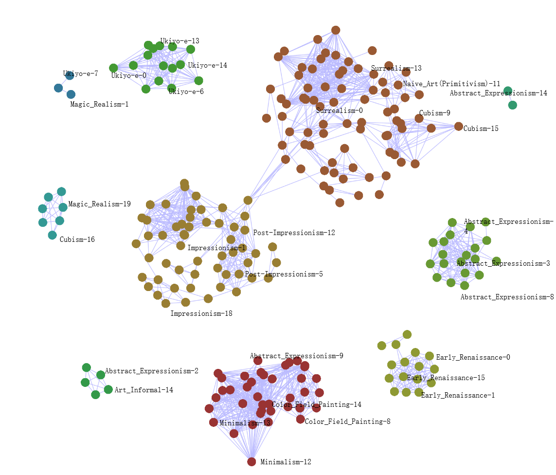
Grivan-Newman Algorithm
Results

Slide 4
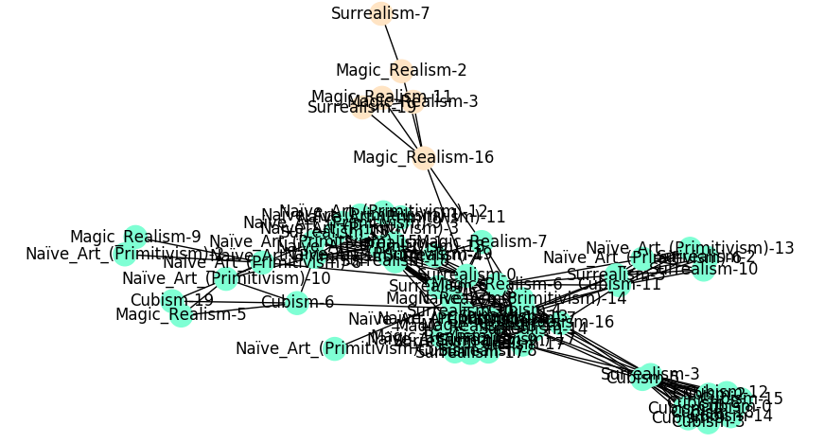
Grivan-Newman Algorithm
Analysis 1
The communities of Cubism, Magic Realism, Naive Art, Surrealism is closed to each other from the result.
CNN recognition accuracy for the 4 painting styles is 81.25%.
Naive Art and Cubism seem reperated, but they are generally connected to others.

Slide 5
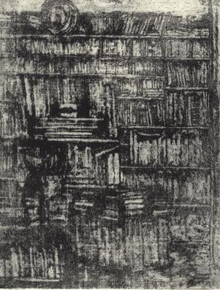
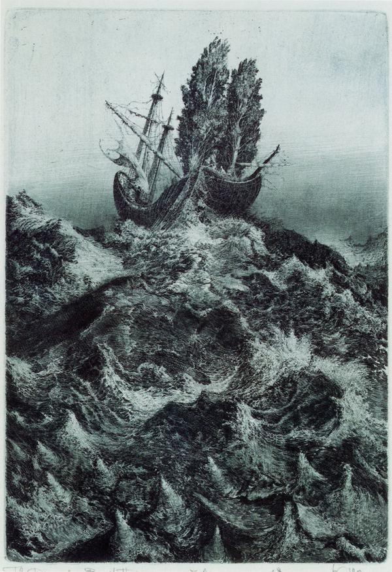
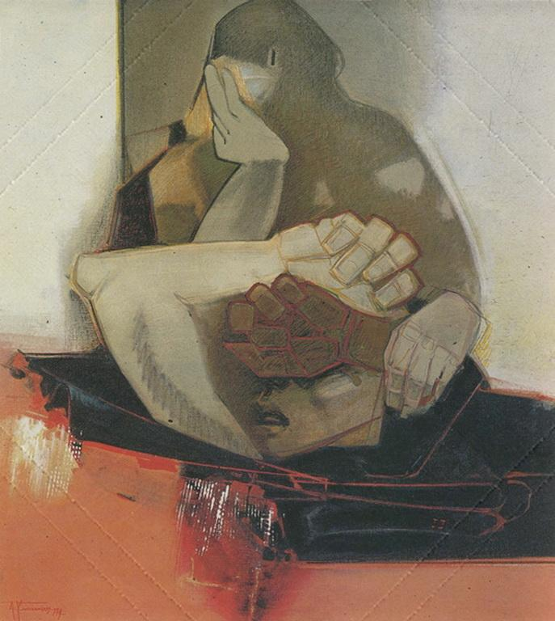
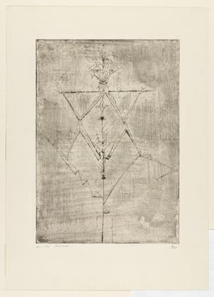
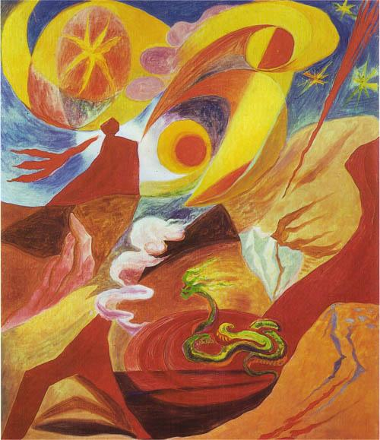
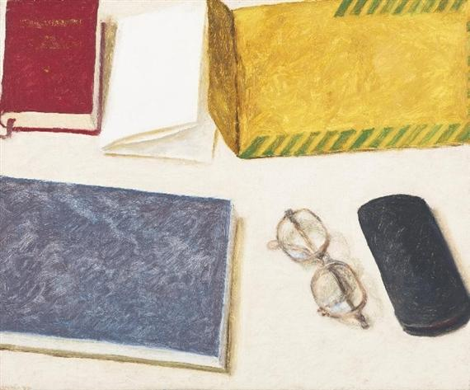
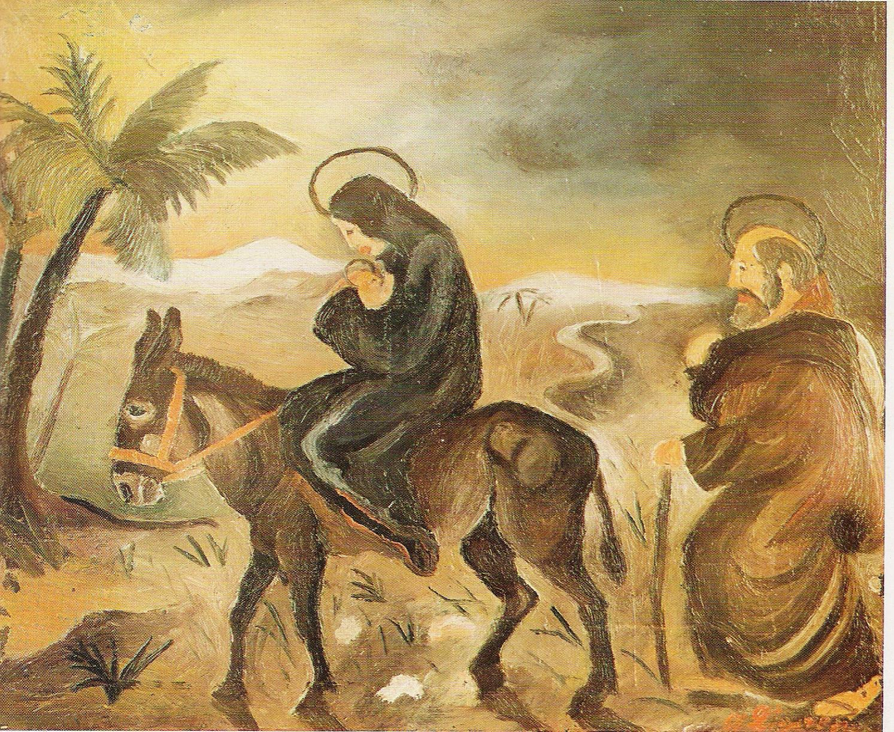
Grivan-Newman Algorithm
Analysis 1
There are many connections between
the 4 style paintings, Some examples here.
a) "Magic realism-3", "Surrealism-19"
b) "Surrealism-3", "Cubism-5"
c) "Cubism-11", "Magic realism-6", "Naive art-16"
We can get some commonality between
them and we have found some reference
to prove this.
a) Surrealism is a further development of Collage, Cubism,
and Dada. (infoplease.com)
b) Both Surrealism and Magic Realism use a mixture of realism
and fantastic elements. (Mia Feigelson Gallery introduction)
c) Important influences on Magic Realism came from
the Naive art of Henri Rousseau and the
Metaphysical works of Giorgio de Chirico.
(tendreams.org/Magic-art.htm)
Magic realism-3
Surrealism-19
Cubism-5
Surrealism-3
Cubism-11
Magic realism-6
Naive art-16

Slide 6
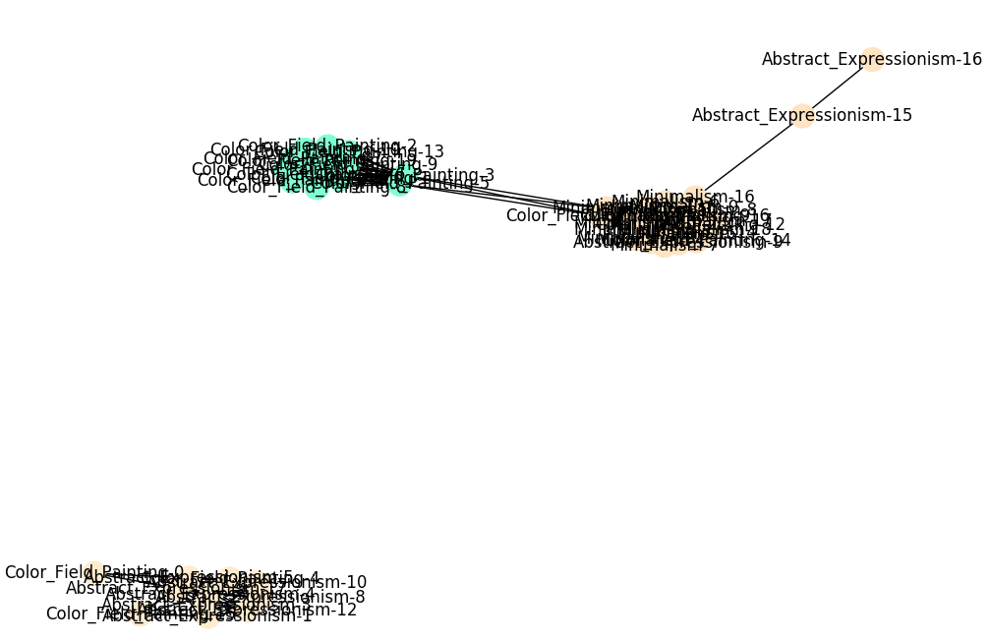
Grivan-Newman Algorithm
Analysis 2
Color Field painting, Minimalism are different styles while they have
something in common with Abstract Expressionism.
CNN recognition accuracy is 90.0%.

Slide 7
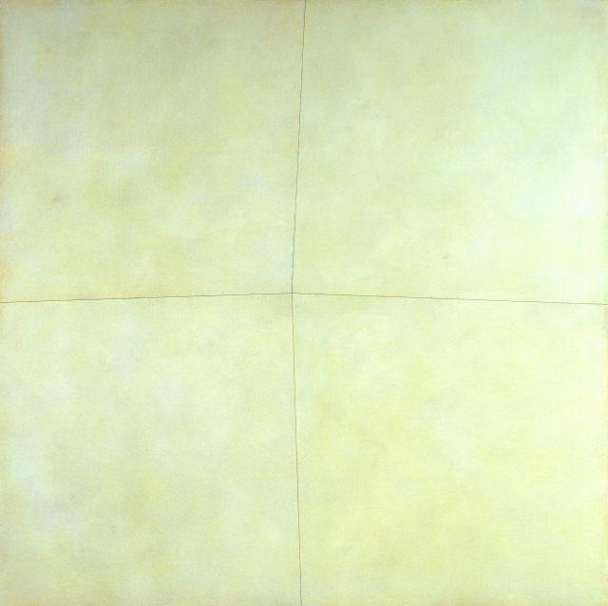
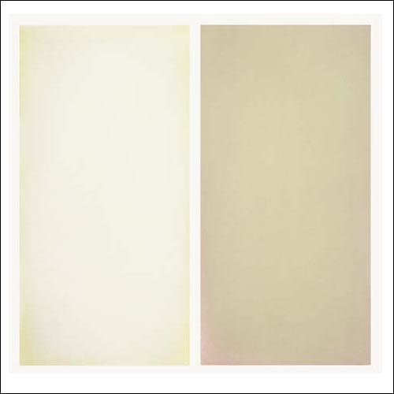
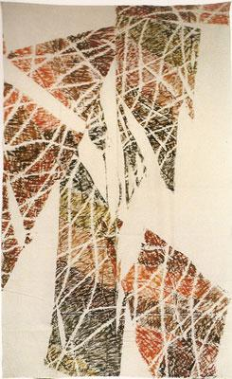
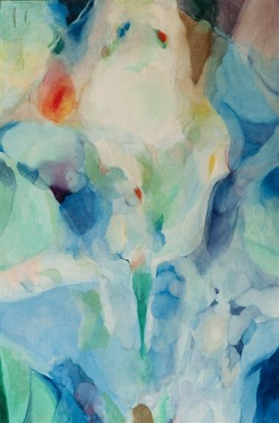
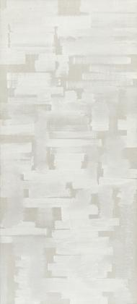
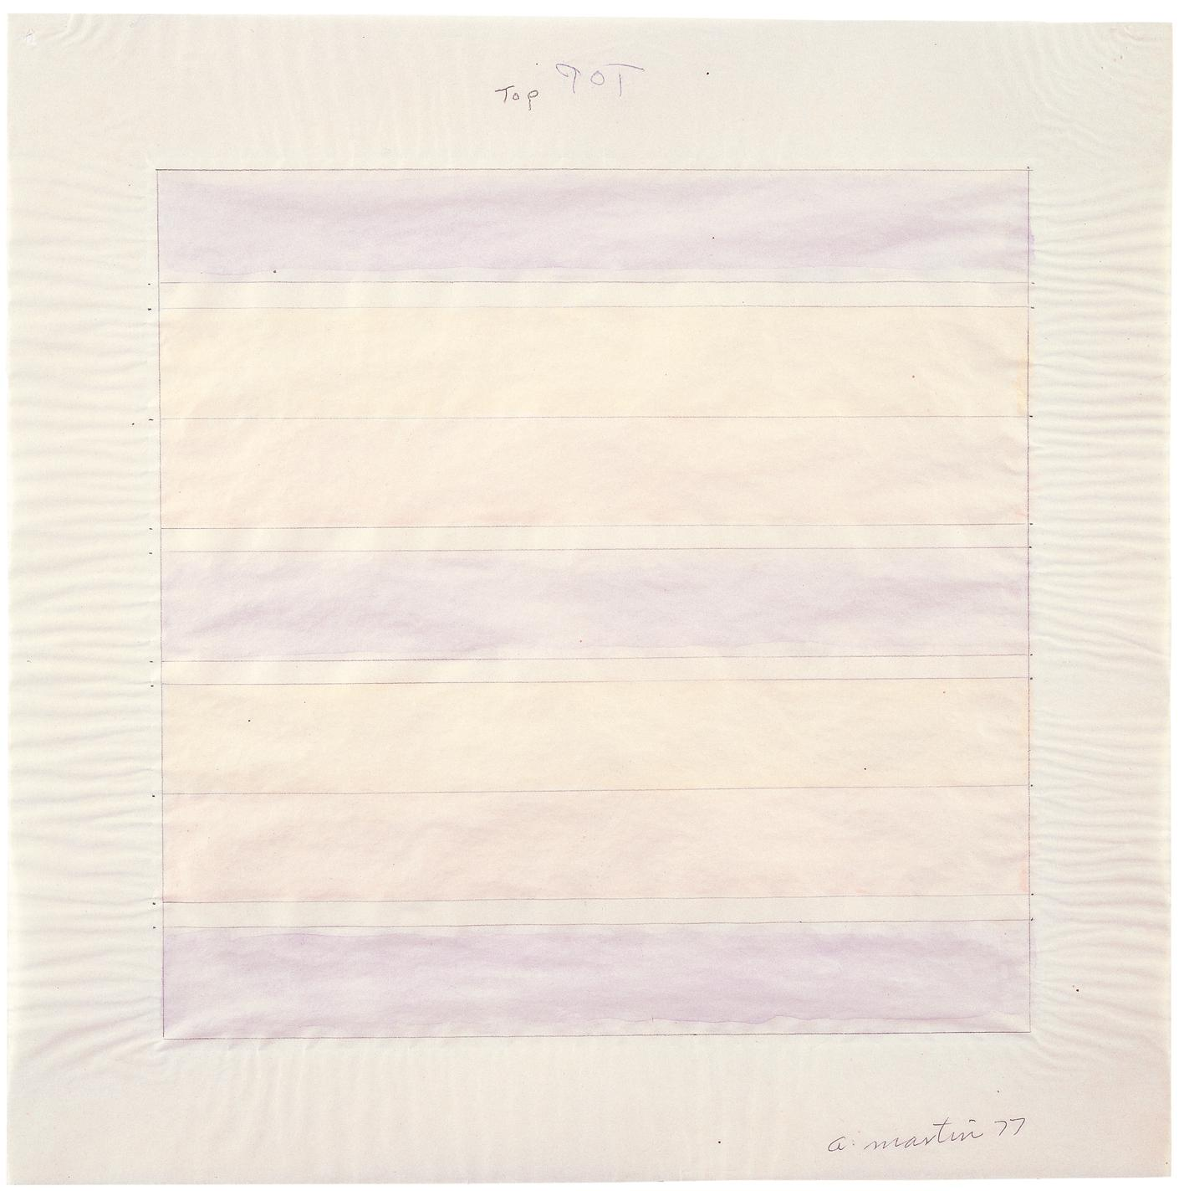
Grivan-Newman Algorithm
Analysis 2
Color Field painting and Minimalism have
two paintings in the same style.
"Minimalism-15" and "Color Field-13" are both in light color.
Abstract Expressionism has connections
with Color Field painting and Minimalism.
a) "Color Field -7", "abstract-expressionism-14"
b) "Minimalism-6", "abstract-expressionism-8"
We have found some reference and known
that both Minimalism and Color Field are
developed from Abstract Expressionism.
a) Color Field painting is a style of abstract painting. It was
inspired by European modernism and closely related to
Abstract Expressionism. (wikipedia)
b) Morris Louis's painting Where 1960, was a major innovation
that moved Abstract Expressionist painting forward in a new direction toward Color Field and Minimalism. (wikipedia)
Minimalism-15
Color Field-13
Color Field-7
Abstract Expressionism-14
Abstract Expressionism-8
Minimalism-6

Slide 8
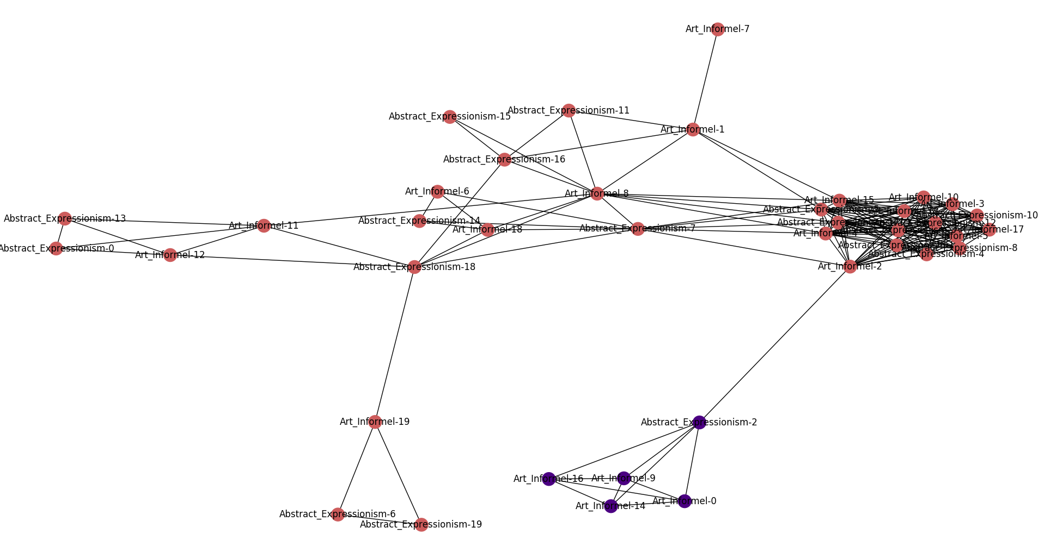
Grivan-Newman Algorithm
Analysis 3
Abstract Expressionism and Art Informal have strong connections.
CNN recognition accuracy is 82.5%. It means that the CNN doesn't
distinguish the two styles very well.

Slide 9
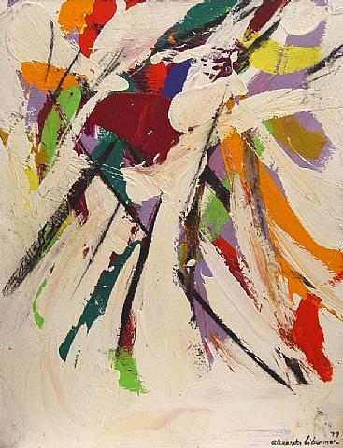
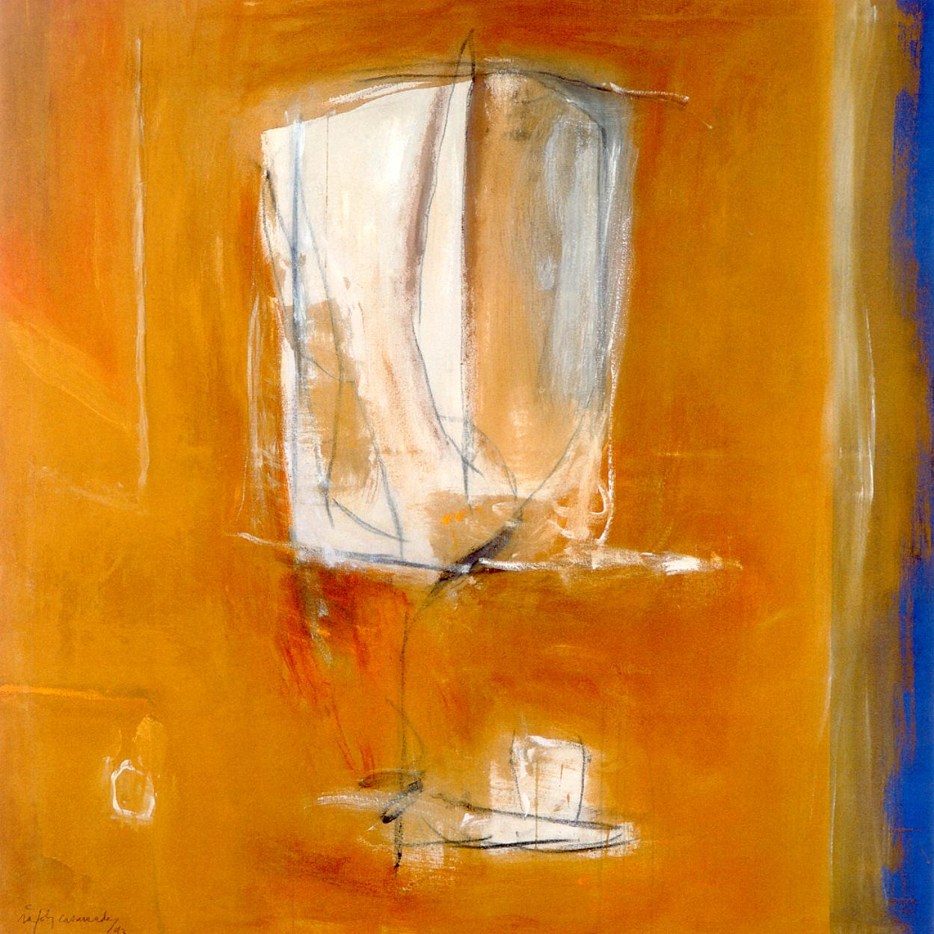
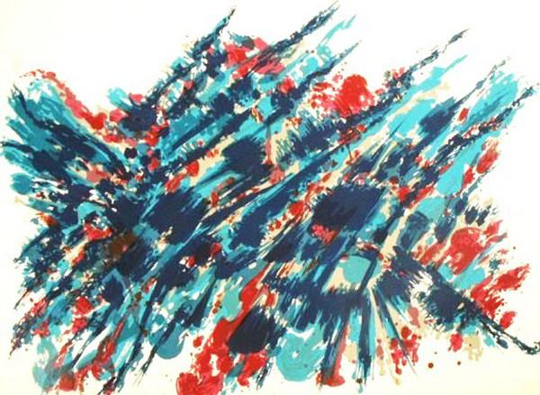
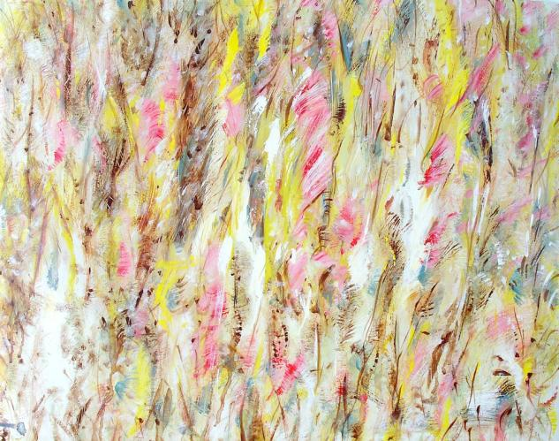
Grivan-Newman Algorithm
Analysis 3
Difference between Abstract Expressionism
and Art Informal is small. Examples here.
a) "Abstract Expressionism-12", "Art Informal-5"
b) "Abstract Expressionism-19", "Art Informal-16"
The two styles are quite similar from the pictures.
There also are evidence to prove this.
The artists associated with Art Informel are sometimes called
the international equivalents of the Abstract Expressionists.
(ideelart.com)
Abstract Expressionism-12
Art Informal-5
Art Informal-16
Abstract Expressionism-19

Slide 10
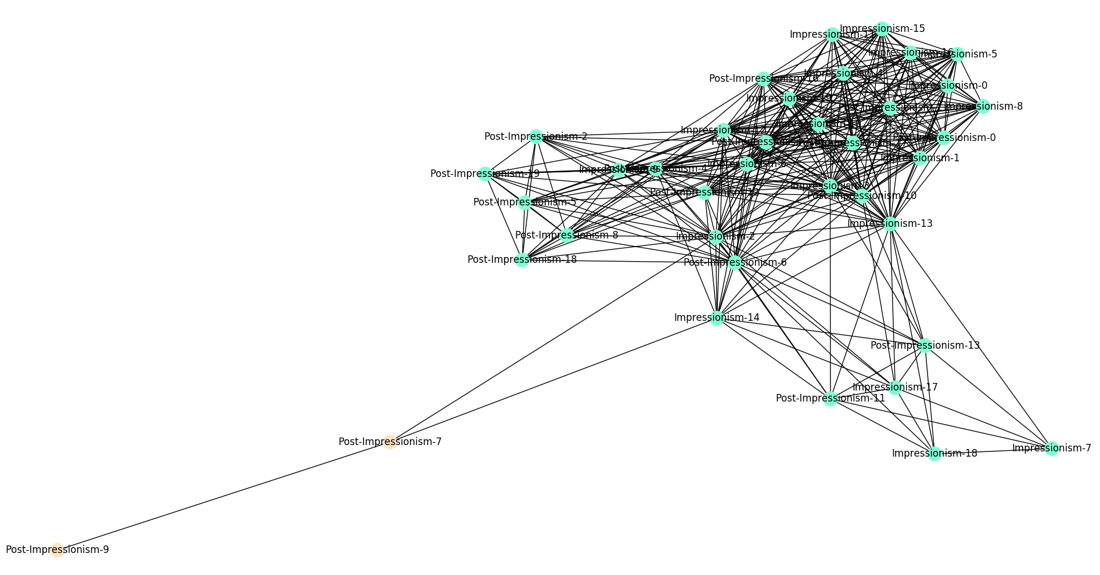
Grivan-Newman Algorithm
Analysis 4
Impressionism and Post-Impressionism also have strong connections.
CNN recognition accuracy is 90.0%.

Slide 11
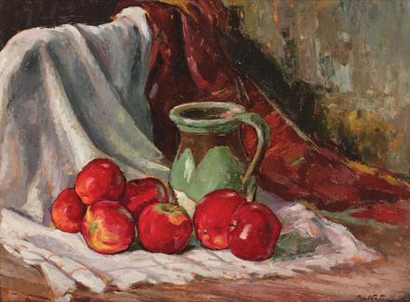
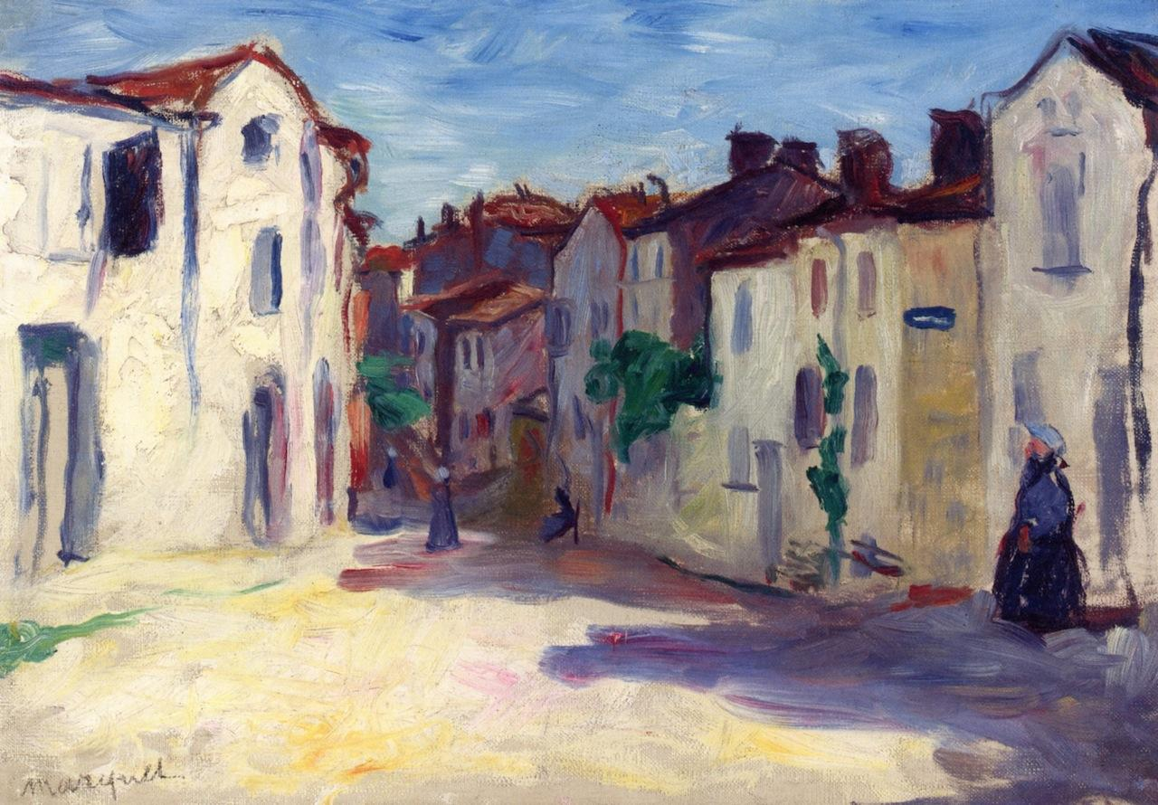
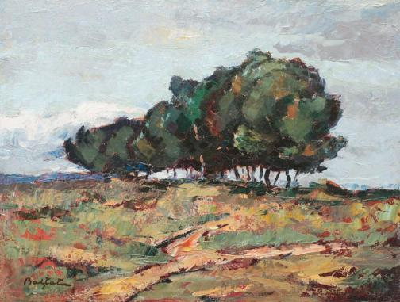
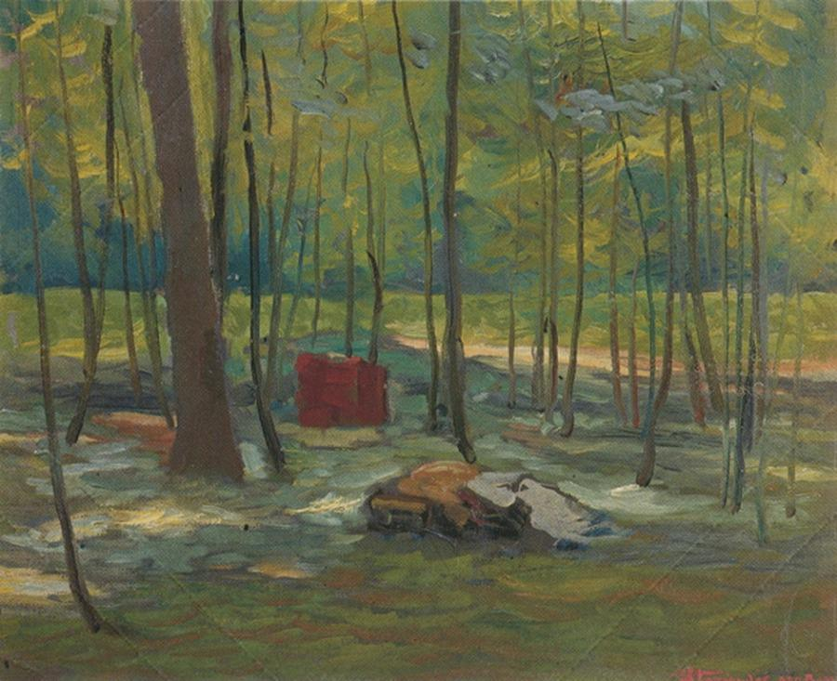
Grivan-Newman Algorithm
Analysis 4
Impressionism and Post-Impressionism are
developed from France in 19th centuray, so
it's reasonable that their communities to be
together. Here are the examples.
a) "Abstract Expressionism-12", "Art Informal-5"
b) "Abstract Expressionism-19", "Art Informal-16"
History of the Impressionism and Post
Impressionsim can be found.
Both Impressionism and Post-Impressionism refer to
influential artistic movements arising in late 19th-century France.
(ideelart.com)
Impressionism-20
Post-Impressionism-14
Impresssionism-5
Post-Impressionism-16

